Slide 1
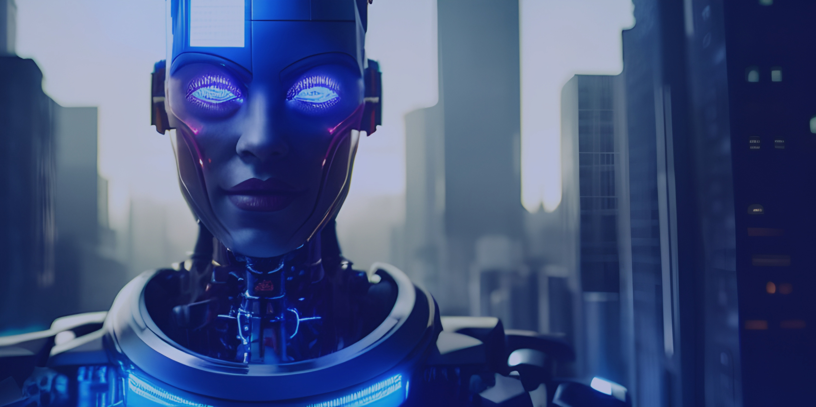


MSP tech club - Helwan University
Machine
Learning
MSP WorkShop
01

Slide 2
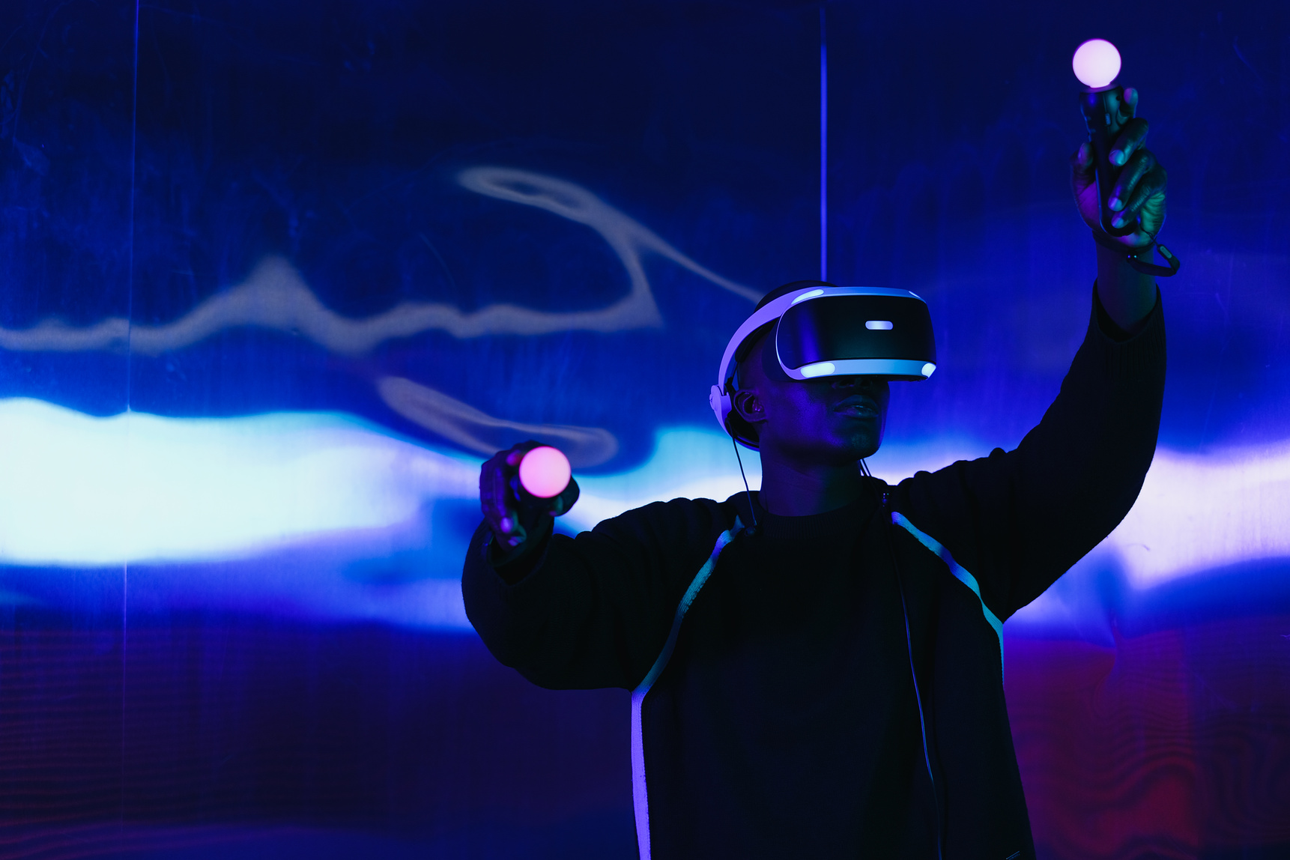
MSP tech club - Helwan University
What Is Artificial Intelligence?
02
Notes:
تعريف بسيط لل AI ؟

Slide 3
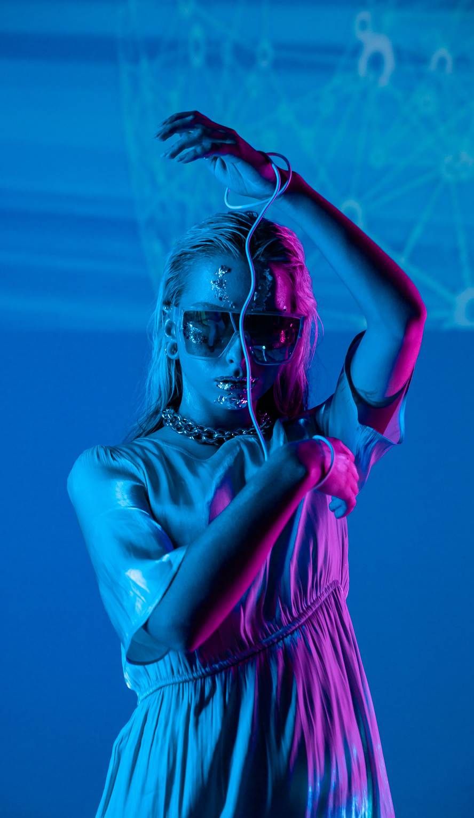
MSP tech club - Helwan University
Types of AI?
Weak AI
Narrow AI
or
Artificial Narrow Intelligence (ANI)
Strong AI
Artificial General Intelligence (AGI)
Artificial Super Intelligence (ASI)
01
02
03
Notes:
تتوقعوا احنا لحد دلوقتي في اني نوع فيهم ؟
احنا لجد دلوقتي في ال Weak AI
طب ايه الفرق بينهم ؟!ّ

Slide 4
MSP tech club - Helwan University
Weak AI
Narrow AI or Artificial Narrow Intelligence (ANI)
01
It is an AI that is trained and focused to perform specific tasks.
It drives most of the AI that surrounds us today.
04
Notes:
موديل متدرب انه يعمل حاجات معينة
ذي مثلا Chat gpt

Slide 5
MSP tech club - Helwan University
Strong AI
Artificial General Intelligence (AGI)
Artificial Super Intelligence (ASI)
02
AGI is a theoretical form of AI where a machine would have an intelligence equal to humans; It would have a self-aware consciousness that can solve problems, Learn , and plan for the future.
ASI would surpass the Intelligence and ability of the human brain
05

Slide 6
MSP tech club - Helwan University
Sub fields of AI
06

Slide 7
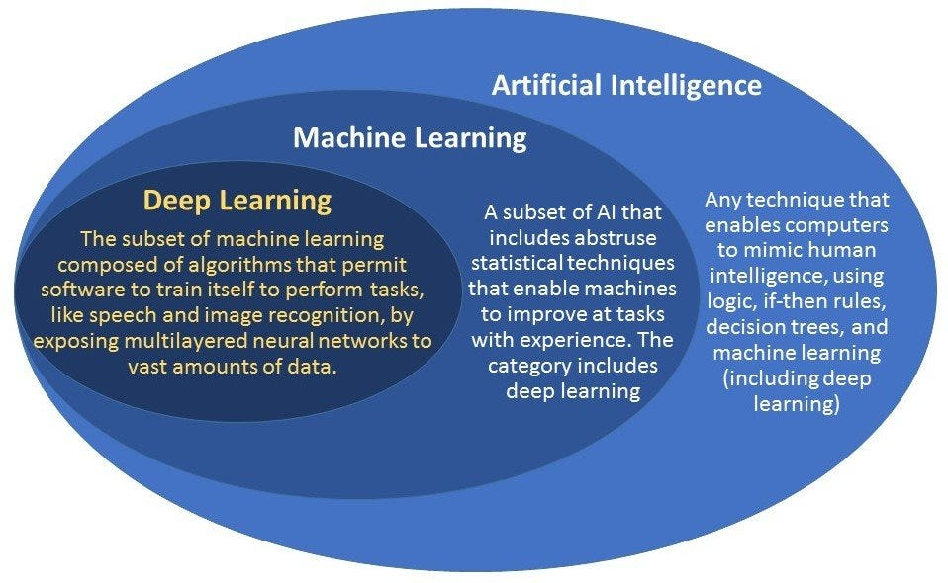
MSP tech club - Helwan University
07

Slide 8
MSP tech club - Helwan University
What is Machine learning?
Machine Learning (ML) is a discipline of AI that provides machines with the ability to automatically learn from data and past experiences while identifying patterns to make predictions with minimal human intervention.
ML methods enable computers to operate autonomously without explicit programming.
ML applications are fed with new data, and they can independently learn, grow, develop, and adapt.
08
Notes:
موديل متدرب انه يعمل حاجات معينة
ذي مثلا Chat gpt

Slide 9
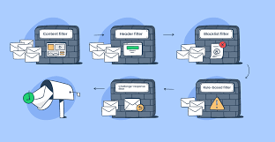
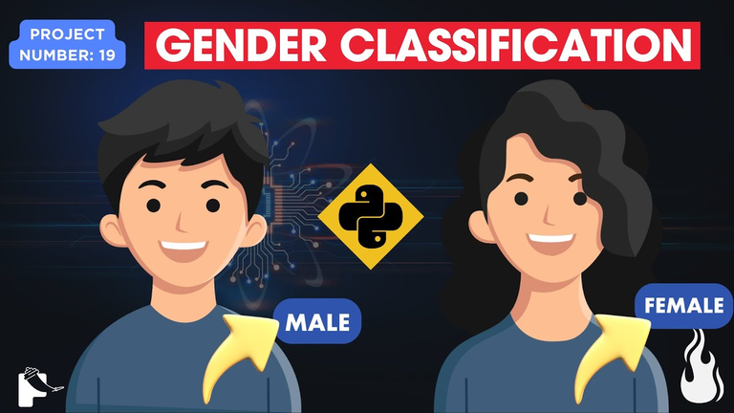
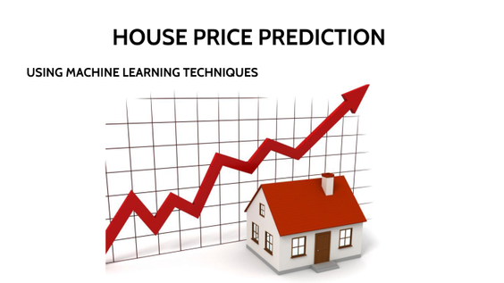
MSP tech club - Helwan University
Projects on AI
Spam Filtering
Breast Cancer Prediction
House Price Prediction
Calories Burned Prediction
Age and Gender Detection
Gender Classification
Heart Disease Prediction
Pneumonia Detection
09
Notes:
موديل متدرب انه يعمل حاجات معينة
ذي مثلا Chat gpt

Slide 10
MSP tech club - Helwan University
What is Deep Learning?
Deep Learning is a type of computer technology inspired by the way our brains work.
It involves using artificial neural networks with many layers to help computers understand and learn from data, like recognizing faces in photos or understanding spoken language.
It’s what makes some AI systems very good at tasks like image and speech recognition.
10
Notes:
موديل متدرب انه يعمل حاجات معينة
ذي مثلا Chat gpt

Slide 11
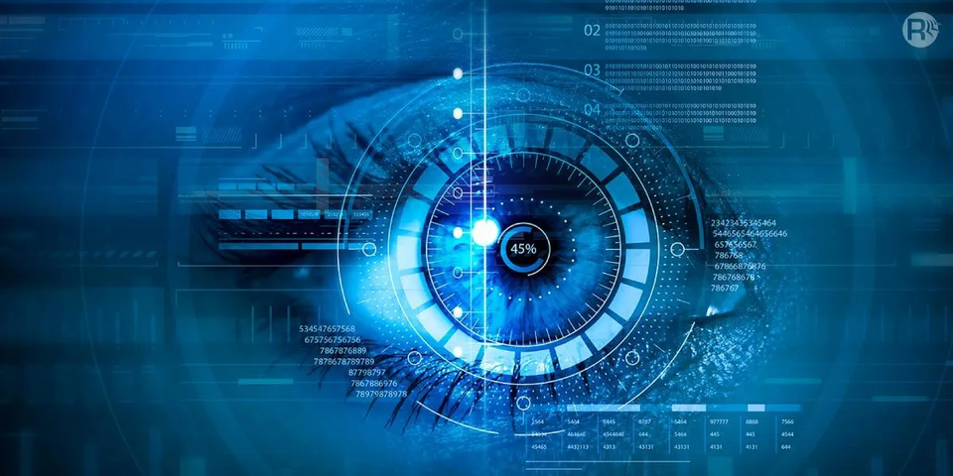
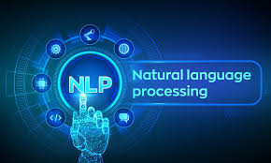
MSP tech club - Helwan University
Sub Applications of Dl
Computer Vision (CV)
Natural Language Processing (NLP)
11
Notes:
موديل متدرب انه يعمل حاجات معينة
ذي مثلا Chat gpt

Slide 12
MSP tech club - Helwan University
What is Computer vision?
Computer vision is a field of AI that enables computers and systems to derive meaningful information from digital images, videos and other visual inputs - and take actions or make recommendations based on that information.
If AI enables computers to think, computer vision enables them to see, observe and understand.
12
Notes:
موديل متدرب انه يعمل حاجات معينة
ذي مثلا Chat gpt

Slide 13
MSP tech club - Helwan University
examples on computer vision
Image Classification: Create a project that can classify images into different categories, for example: you can build a model that distinguishes between cats and dogs.
Object Detection: Develop a system that can detect specific objects in images or a video feed. you could create an application that detects, and highlights faces in a live webcam stream.
Lane Detection for Autonomous Cars: Build a simple lane detection system that can identify lanes on a road using computer vision. This is a small-scale version of what self-driving cars use.
13
Notes:
موديل متدرب انه يعمل حاجات معينة
ذي مثلا Chat gpt

Slide 14
MSP tech club - Helwan University
examples on computer vision
Handwriting Recognition: Create a handwriting recognition system that can read and convert handwritten text into digital text.
Color Recognition: Build a program that can identify and name the colors in an image. This is a great project for learning about color analysis in computer vision.
Fruit or Vegetable Ripeness Detector: Create a system that can determine the ripeness of fruits or vegetables from images. this could be used in food quality control.
14
Notes:
موديل متدرب انه يعمل حاجات معينة
ذي مثلا Chat gpt

Slide 15
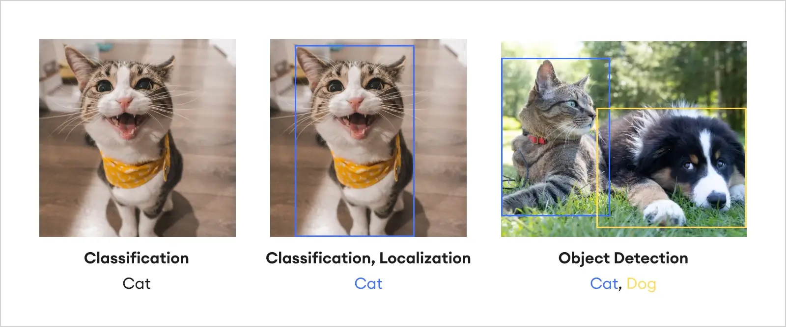
Image Classification

Slide 16
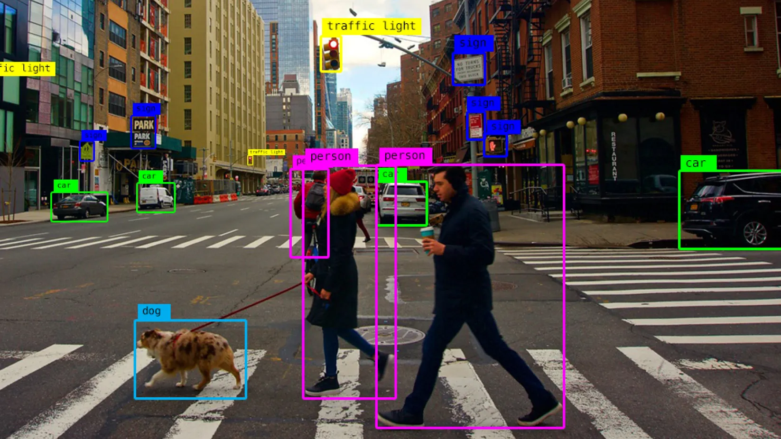
Object Detection

Slide 17
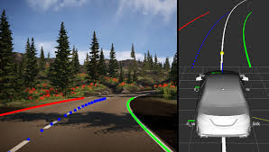
Lane Detection for Autonomous Cars

Slide 18
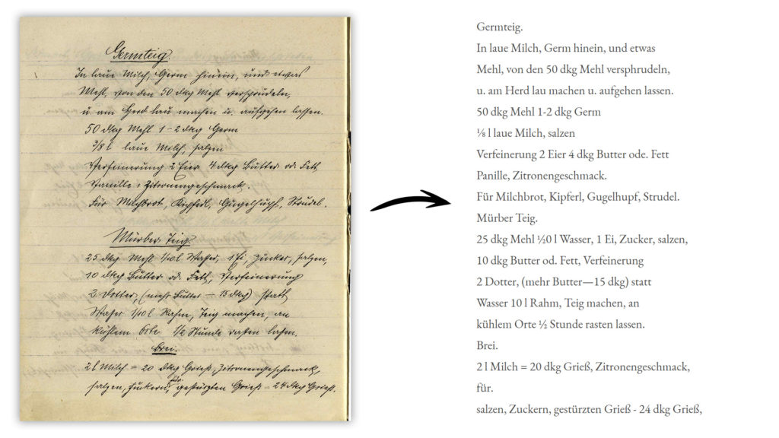
Handwriting Recognition

Slide 19
MSP tech club - Helwan University
What is Natural language Processing (NLP)?
NLP refers to the branch of computer science - and more specifically, the branch of AI - concerned with giving computers the ability to understand text and spoken words in much the same way human beings can.
15
Notes:
موديل متدرب انه يعمل حاجات معينة
ذي مثلا Chat gpt

Slide 20
MSP tech club - Helwan University
examples on Nlp
Text classification
Part-of-Speech Tagging (POS)
Text Summarization
Sentiment Analysis ( positive or negative review )
Machine Translation
Language Generation
16
Notes:
موديل متدرب انه يعمل حاجات معينة
ذي مثلا Chat gpt

Slide 21
MSP tech club - Helwan University
What about the future of AI?
17

Slide 22
MSP tech club - Helwan University
Can AI replace human jobs?
18

Slide 23
MSP tech club - Helwan University
The answer in simple way is noooo!!!
Did calculators replace math teachers’ jobs when they were invented?
Not at all; they simply made certain tasks easier and faster.
Similarly, with AI, It mostly replaces basic jobs that don’t need creativity, while speeding up other tasks.
19
Notes:
موديل متدرب انه يعمل حاجات معينة
ذي مثلا Chat gpt

Slide 24
MSP tech club - Helwan University
how will ai reshape the future and its jobs?
Automation and job displacement
Job Transformation
New Job Creation
Ethical and Regulatory Roles
20
Notes:
موديل متدرب انه يعمل حاجات معينة
ذي مثلا Chat gpt

Slide 25

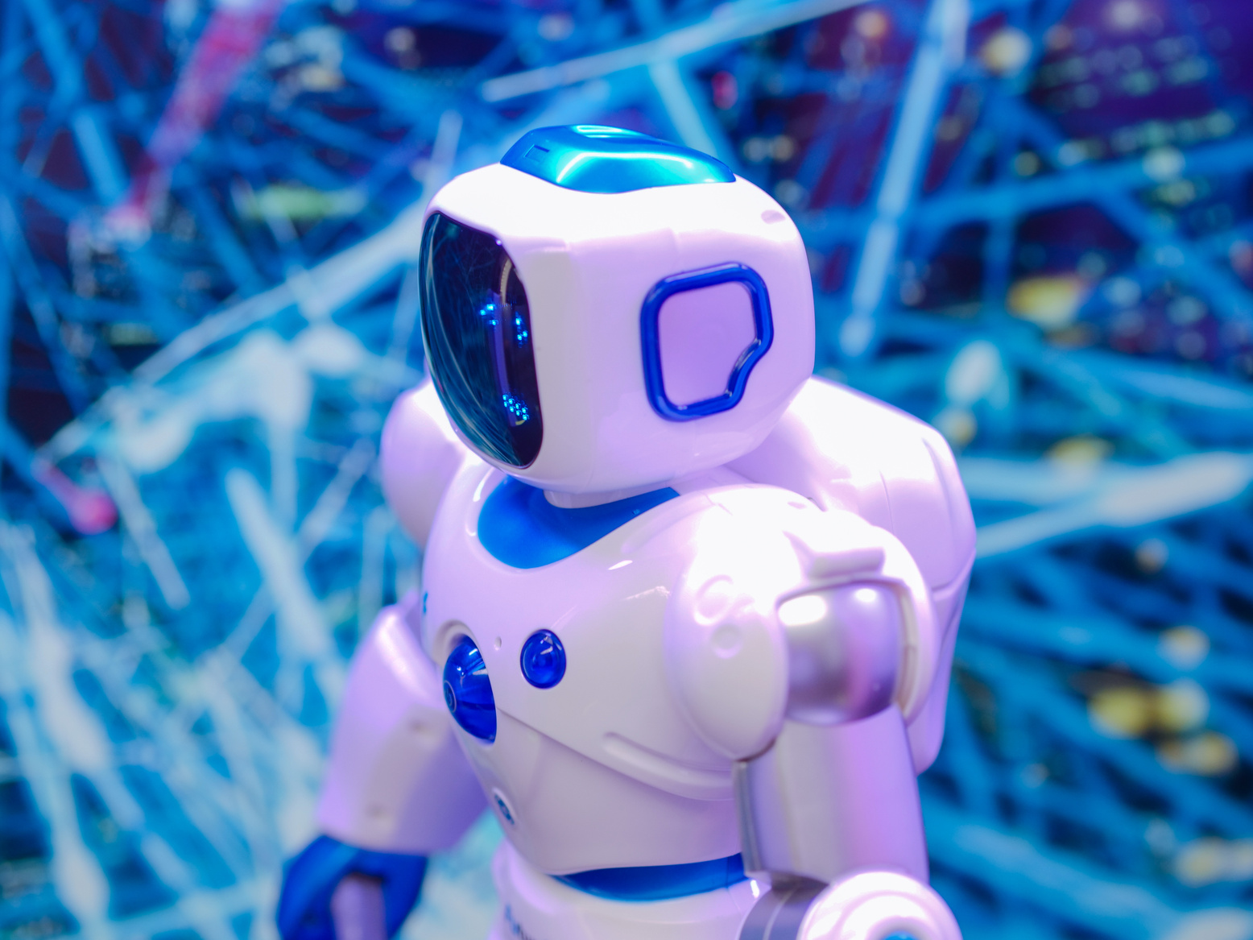


MSP tech club - Helwan University
Contact me
WhatsApp
LinkedIn : Malak Al-Aabiad
Github : Malak-Alaabiad
Kaggle : Malak Al-Aabiad
malakkalaabiadd@gmail.com
21

Slide 26
MSP tech club - Helwan University
Thank You
For your attention
see you next session
22

